Slide 1
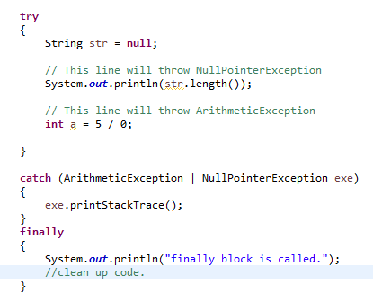
The finally Block
The finally block always executes when the try block exits. This ensures that the finally block is executed even if an unexpected exception occurs.
finally block allows the programmer to avoid having cleanup code accidentally bypassed by a return, continue, or break. Putting cleanup code in a finally block is always a good practice, even when no exceptions are anticipated.
If the JVM exits while the try or catch code is being executed, then the finally block may not execute. Likewise, if the thread executing the try or catch code is interrupted or killed, the finally block may not execute even though the application as a whole continues.
The runtime system always executes the statements within the finally block regardless of what happens within the try block. So it's the perfect place to perform cleanup.
The finally block is a key tool for preventing resource leaks. When closing a file or otherwise recovering resources, place the code in a finally block to ensure that resource is always recovered.

